Slide 1

Making custom apps accessible to outsiders
Dafni Roumba 20/07/2023

Slide 2
Main Topics
1
4
Introduction
App Creation
2
5
SCOR Servers
Flask & HTML
3
6
Sharing Scripts
Example

Slide 3
Introduction
How did we end up here?
Step 1
Wanted to automate a process for another team that doesn’t use programming. For this I needed specific packages that existed only on SCOR’s Data Science Sandbox server.
Step 2
I started thinking of ways to send my script to the other team but because of these specific packages, I initially thought they would have to get access to the server.
Step 3
The solution provided by the DataScience team was to create an interface from which they can run my scripts through the server without accessing the code files themselves.

Slide 4


SCOR Servers
To replace a picture :
Right click on the picture
Click on « Change Picture » / « From a file... »
Choose your picture (1920x1080px)
What’s available to us
SCOR has these two servers (based on my current knowledge) which are similar but have their pros and cons:
Data Science Sandbox
Domino
Details on these are summarized in the shared pdf.

Slide 5

Sharing Scripts
To replace a picture :
Right click on the picture
Click on « Change Picture » / « From a file... »
Choose your picture (1920x1080px)
with other SCOR teams
You create a code meant to be used by another team. What now?
Depending on the team, they might
have different access rights to the servers
not use same programming languages/packages
have no need of computational solutions on the regular
What’s the best way to give them access to your code?
Option 1:
Email a Data team, create team accounts and accesses, make sure they have the same packages available, help them through the code…..
Option 2:
Give access to specifically your scripts on your server that you can already run.

Slide 6

App Creation
To replace a picture :
Right click on the picture
Click on « Change Picture » / « From a file... »
Choose your picture (1920x1080px)
We’re not going to develop the New Facebook, don’t worry!
App creation in this sense is essentially creating a REST API.
An API, or Application Programming Interface, is a set of rules that define how applications or devices can connect to and communicate with each other.
A REST API is an API that conforms to the design principles of the Representational State Transfer Architectural Style.
There are many beginner friendly packages to create simple REST API’s but I will go through Flask that’s available in Python.

Slide 7
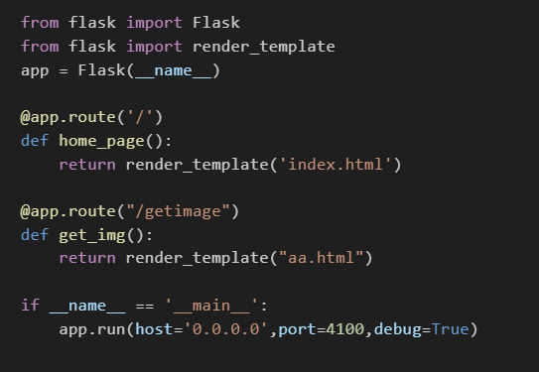
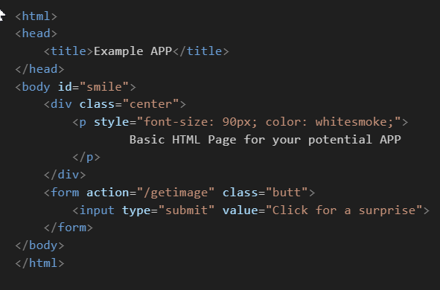
Flask & HTML
To modify progress bar :
Right click on the horizontal bar chart
« Edit data » > an Excel window is open
Add your datas in this Excel window
Quit the Excel window
A quick intro
The simplest way to create an app using Flask and HTML is to create a .py file and a .html file.
The Python and HTML script should look something like:
To replace a picture :
Right click on the picture
Click on « Change Picture » / « From a file... »
Choose your picture (1920x1080px)
Flask (.py)
HTML (.html)

Slide 8
Example APP (scor.local)
Excel Management (scor.local)

Slide 9

Thank You
Dafni Roumba
21/06/2023

Slide 10


